Slide 1
Cloud Misconfigurations

Slide 2
What Is a Cloud Misconfiguration?
A cloud misconfiguration occurs when cloud infrastructure is not properly set up according to security best practices.
Common Examples
Result
S3 buckets set to public (readable by anyone)
Security groups allowing unrestricted access
Overly permissive IAM policies
Unencrypted databases
Disabled logging and monitoring
Default credentials left unchanged
Unauthorized access, data breaches, and compliance violations.

Slide 3

Capital One Breach (2019)
What Happened
Root Cause
Attacker exploited a misconfigured Web Application Firewall (WAF)
Gained access to AWS environment
Extracted data of 100+ million customers
Exposed: Names, SSNs, credit card numbers
Misconfigured IAM role with excessive permissions
Impact
700 million USD settlement + reputational damage
Lesson
One misconfiguration can lead to massive breaches.

Slide 4

The Shared Responsibility Model
Cloud providers (AWS, Azure, GCP) and customers each own a distinct layer of security.
Cloud Providers Secure
YOU Are Responsible For
Physical infrastructure
Network security
Hypervisor security
Storage encryption (at rest)
IAM policies and access control
Application security
Data encryption (in transit)
Security group configurations
Logging and monitoring
Patch management
User access management
Misconfigurations happen in YOUR layer.

Slide 5
Top 5 Cloud Misconfigurations
Overly Permissive IAM Policies
1
Problem: Users have more permissions than needed
Risk: Insider threats, lateral movement
Fix: Apply principle of least privilege
Publicly Exposed Storage
2
Problem: S3 buckets, Azure blobs set to public
Risk: Data exposure, compliance violations
Fix: Enable bucket policies, access controls
Unencrypted Data
3
Problem: Data stored without encryption
Risk: Data breaches if storage is compromised
Fix: Enable encryption at rest and in transit
Disabled Logging and Monitoring
4
Problem: CloudTrail, VPC Flow Logs disabled
Risk: Cannot detect or investigate breaches
Fix: Enable all logging services
Insecure Network Configuration
5
Problem: Security groups allow 0.0.0.0/0 access
Risk: Unauthorized access to databases, servers
Fix: Restrict to specific IP ranges

Slide 6
Impact of Misconfigurations
💰 Financial Impact
⚙️ Operational Impact
🔒 Security Impact
Average cost of a cloud breach: 4.45 million USD
Regulatory fines: Up to 4% of annual revenue (GDPR)
Incident response costs: 1–2 million USD
System downtime and service disruption
Loss of customer trust and reputation damage
Legal and compliance violations
Data loss and intellectual property theft
Unauthorized access to sensitive data
Lateral movement within cloud environment
Ransomware deployment
Long-term persistence of attackers

Slide 7
How to Detect Misconfigurations
1. Cloud Security Posture Management (CSPM)
2. Cloud Access Security Brokers (CASB)
Tools: Netskope, McAfee MVISION
Tools: Prisma Cloud, Microsoft Defender for Cloud, Qualys CSPM
Function: Monitors cloud app usage and detects unauthorized access
Function: Continuously scans cloud infrastructure for misconfigurations against best practices
3. Manual Audits
4. Automated Scanning
Regular security assessments
Configuration reviews
Penetration testing
Infrastructure as Code (IaC) scanning
Policy-as-Code enforcement
Continuous compliance monitoring

Slide 8






Best Practices to Prevent Misconfigurations
1. Principle of Least Privilege (PoLP)
2. Enable Encryption
Grant minimum permissions required
Regularly audit and remove unused access
Use temporary credentials
Encrypt data at rest (S3 server-side encryption)
Encrypt data in transit (TLS/SSL)
Use key management services (KMS)
3. Implement Strong Access Controls
4. Enable Logging and Monitoring
Use Multi-Factor Authentication (MFA)
Implement role-based access control (RBAC)
Monitor privileged accounts
CloudTrail (AWS), Azure Activity Log, GCP Audit Logs
VPC Flow Logs for network monitoring
Real-time alerting on suspicious activity
5. Regular Security Assessments
6. Infrastructure as Code (IaC)
Quarterly configuration reviews
Annual penetration testing
Vulnerability scanning
Use Terraform, CloudFormation, ARM templates
Version control configurations
Scan IaC for security issues before deployment

Slide 9
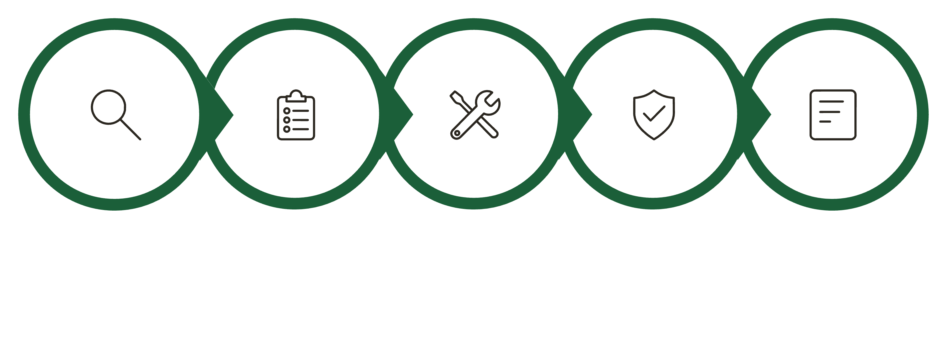





Remediation Workflow
Documentation
Discovery
Assessment
Remediation
Validation
Each step in the workflow builds on the previous: from Discovery through Assessment, Remediation, Validation, and Documentation, culminating in Continuous Monitoring to prevent configuration drift and policy violations over time.

Slide 10
Tools for Cloud Security
Cloud Security Posture Management (CSPM)
Encryption and Key Management
Logging and Monitoring
Prisma Cloud (Palo Alto Networks)
Microsoft Defender for Cloud
Qualys CSPM
CloudSploit
AWS CloudTrail, Azure Activity Log, GCP Audit Logs
Splunk, ELK Stack, Datadog
AWS KMS, Azure Key Vault, Google Cloud KMS
HashiCorp Vault
Infrastructure as Code (IaC) Scanning
Checkov
Terraform Cloud
CloudFormation Guard
Snyk
Identity and Access Management
AWS IAM, Azure AD, Google Cloud IAM
Okta
HashiCorp Vault

